Slide 1

Course Registration System
(using Core JAVA, Rest, Dropwizard & SQL)
Presenters:
Gursimran Kaur Saini
Shivam Pandey
Ayushma Sharma
Anushka Srivastava
Anima Mundra
Chethana T.S

Slide 2
What was planned for us?
The Pre Joining Program to make us project ready.
Started after the warm welcome by Flipkart and a really fun activity.
Read the pre reads of the topics of the pre learning program.
Had some prior knowledge of the industry standard working principles.
Some knowledge of the tools and technologies used in production.
In the end, now we are confident that we are project ready.

Slide 3
Framework for 2 Weeks
2 weeks plan (2022, 6th June - 2022, June 18th)
Every Day Discussion about cool industry Tools / Technologies and Doubt clearance.
Discussion of Project progress & transformation based on UML & Technologies happened every day with SME.
- Started every morning session with review of progress report of project along with debugging and error solving if there’s any.
- Every session ends with a crystal clear description of the tasks that needs to be performed for project development.

Slide 4

Stakeholders
Sponsors
Flipkart
SME’s
1. SME
2. L & D Team, Flipkart
3. HR Team, Flipkart
Trainers
Trainers
Assess
Course-Corrections

Slide 5
Our next starts
NOW
Notes:
Time – 1 min
Swati

Slide 6
2 WEEKS OF TRAINING + PROJECT DEMO
12 DAYS
288 HOURS
17,280 MINUTES
1,036,800 SECONDS
LOTS OF LEARNING

Slide 7

Agenda
01
Our Journey
02
Our Team
03
Project Goals
04
Engineering Practices
05
Tech Stack
06
Development
07
Challenges & Learnings
08
Demo
09
Questions
Notes:
Time – 1 min

Slide 8

Our Journey
Notes:
Time - 2 mins

Slide 9
Agenda of sessions
Introduction to Unix/Linux
Introduction to GIT And Github
SDLC and OOAD With UML Modeling
Core Java Programming
Dropwizard, MySQL Fundamentals
Project

Slide 10
Demo
Mindset
Process
5
Deployed the project using JAVA, Jersey and Dropwizard
Tools
4
Wrote JAVA core production code for the problem based on UML models.
Comprehend
3
Decided the Technologies JAVA/REST/Dropwizard/Git
2
Designed the UML diagrams for the problem.
1
1
Started with linux and git. Learned UML and SDLC and done analysis of problem statement using UML modelling.

Slide 11

Our Team
Notes:
Time – 2 mins

Slide 12
Amit Balyan
SME
Trainees
Gursimran Kaur Saini
Shivam Pandey
Ayushma Sharma
Anushka Srivastava
Anima Mundra
Chethana T.S

Slide 13

Project Goals
Notes:
Time – 3 mins

Slide 14




Our Vision
To create a Course Registration System using Java development tools and technologies, REST and Dropwizard. Couple it with MySQL where a user can have one of the 3 roles - Admin, Professor or Student and perform actions according to role.
All the functionalities like viewing courses, grades, recording grades, adding, deleting, viewing users and course by ADMIN needs to be implemented.
1
2
Quality
Security
3
4
Interactivity
Speed
Notes:
User satisfaction and brand value

Slide 15

Engineering Practices
Notes:
Time – 5 mins

Slide 16
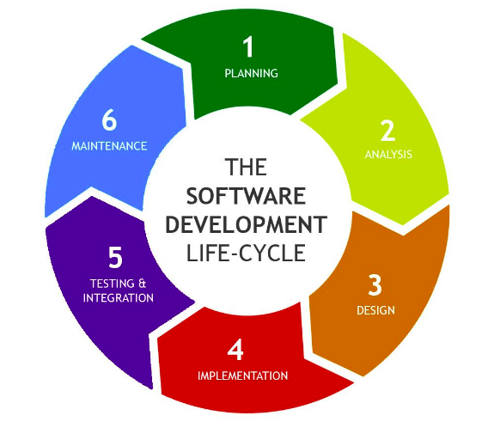
Notes:
Product Thinking (Design Thinking, Requirement Analysis, )
Multi Skilled (Frontend, Backend, DevOps)
Fast Decision Making (Agile)
Increasing the Pace (Automation CI/CD)
Startup Mindset (Agile)
Continuous Improvement (Retros)

Slide 17
Diagrams Link:
https://drive.google.com/drive/folders/1UmBe5rNGwQ02VqgAjm9BIGJMQkPtPLaM?usp=sharing
Project URL:
https://github.com/gursimran18/Flipkart-2022-Jedi-Group-E

Slide 18

Tech Stack
Notes:
Time – 2 mins

Slide 19









Backend
Data
Tools
VCS
Core Language
SQL Database
Framework
Testing
Modelling
Application Server
Notes:
Time – 1 min

Slide 20

Development
Notes:
Time – 1 min

Slide 21
Modeling based on UML
Understanding of Problem Statement
Requirement understanding
Research and analysis
Estimation
Project Planning
Project Grooming
Delivery
Project Implementation
Development using JAVA
Addition of database
Code Review
VC using GIT
Refractor
Integrate
Deploy
Test
Notes:
Time – 1 min

Slide 22
UML DIAGRAMS

Slide 23
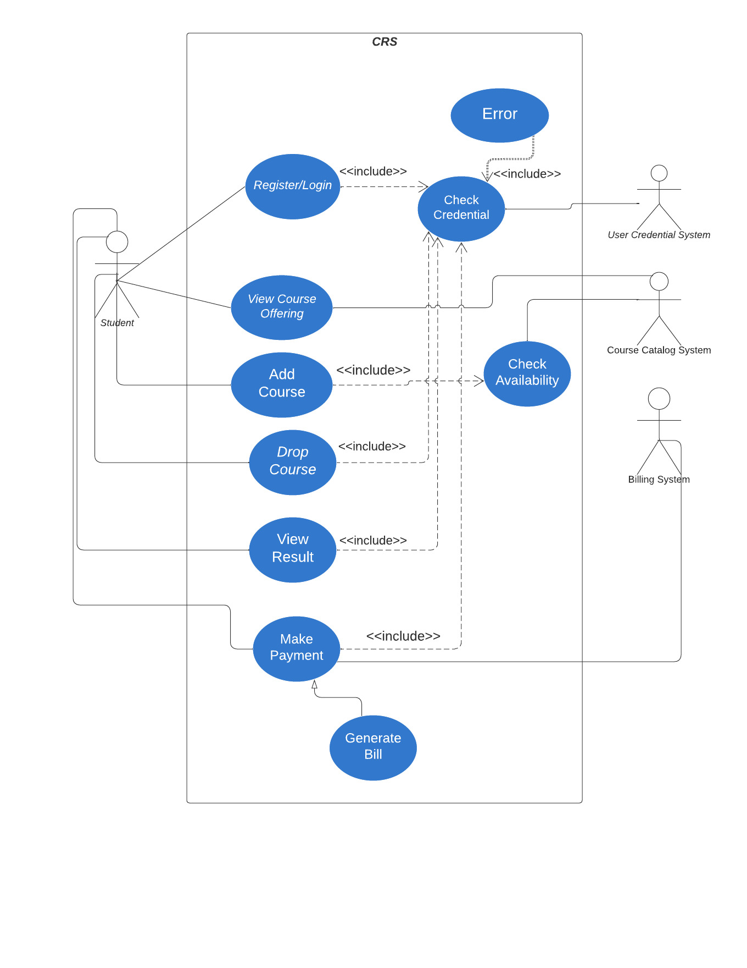
Use Case Diagram - Student

Slide 24
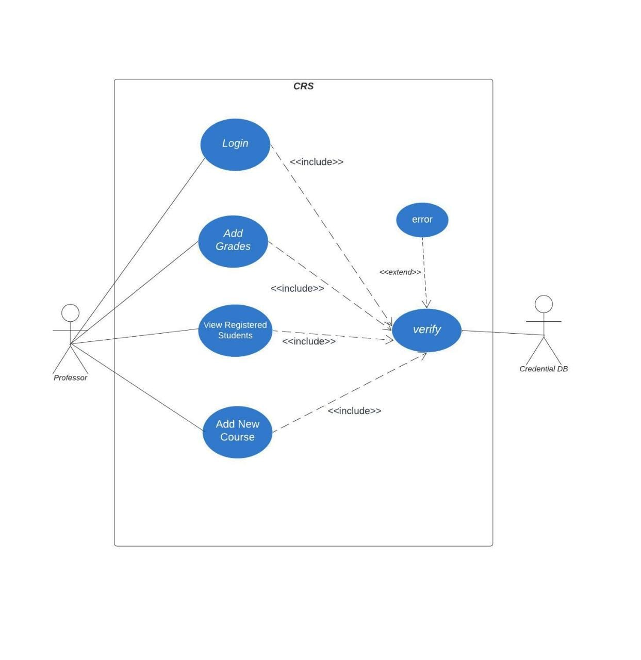
Use Case Diagram - Professor

Slide 25
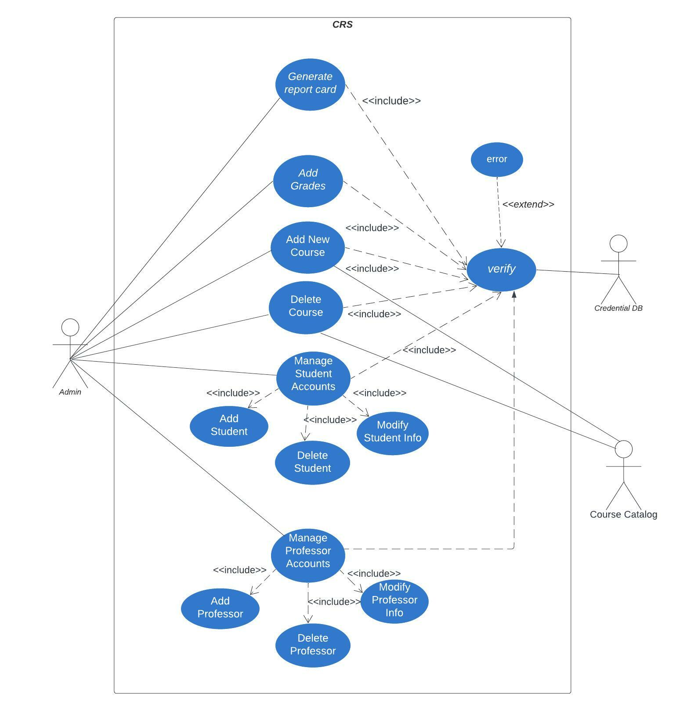
Use Case Diagram - Admin

Slide 26
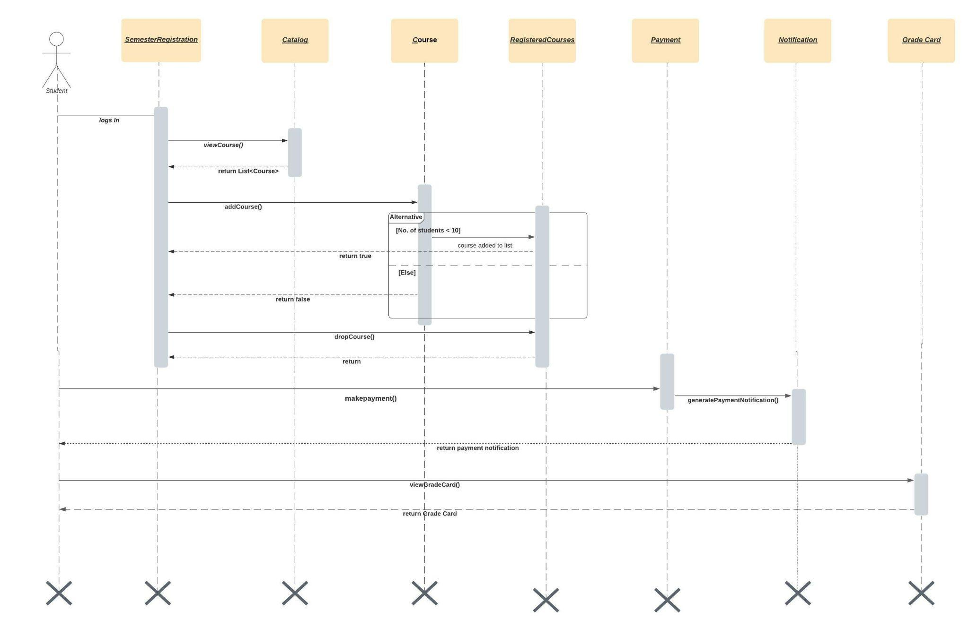
Sequence Diagram - Student

Slide 27
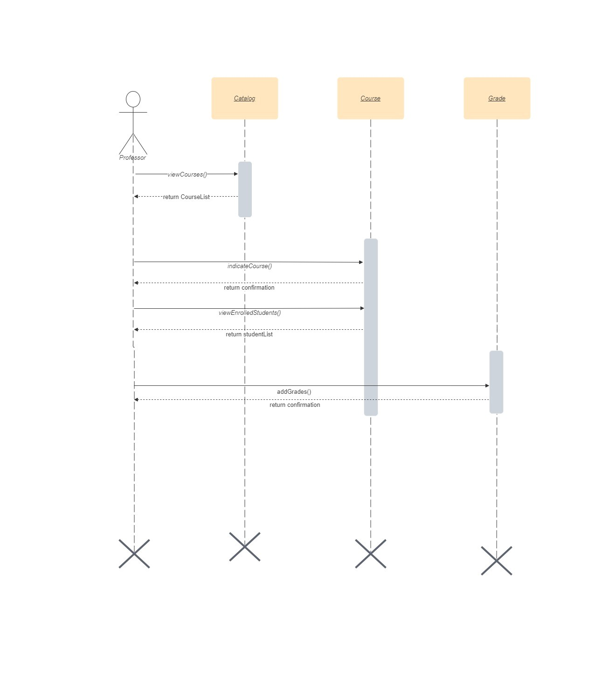
Sequence Diagram - Professor

Slide 28
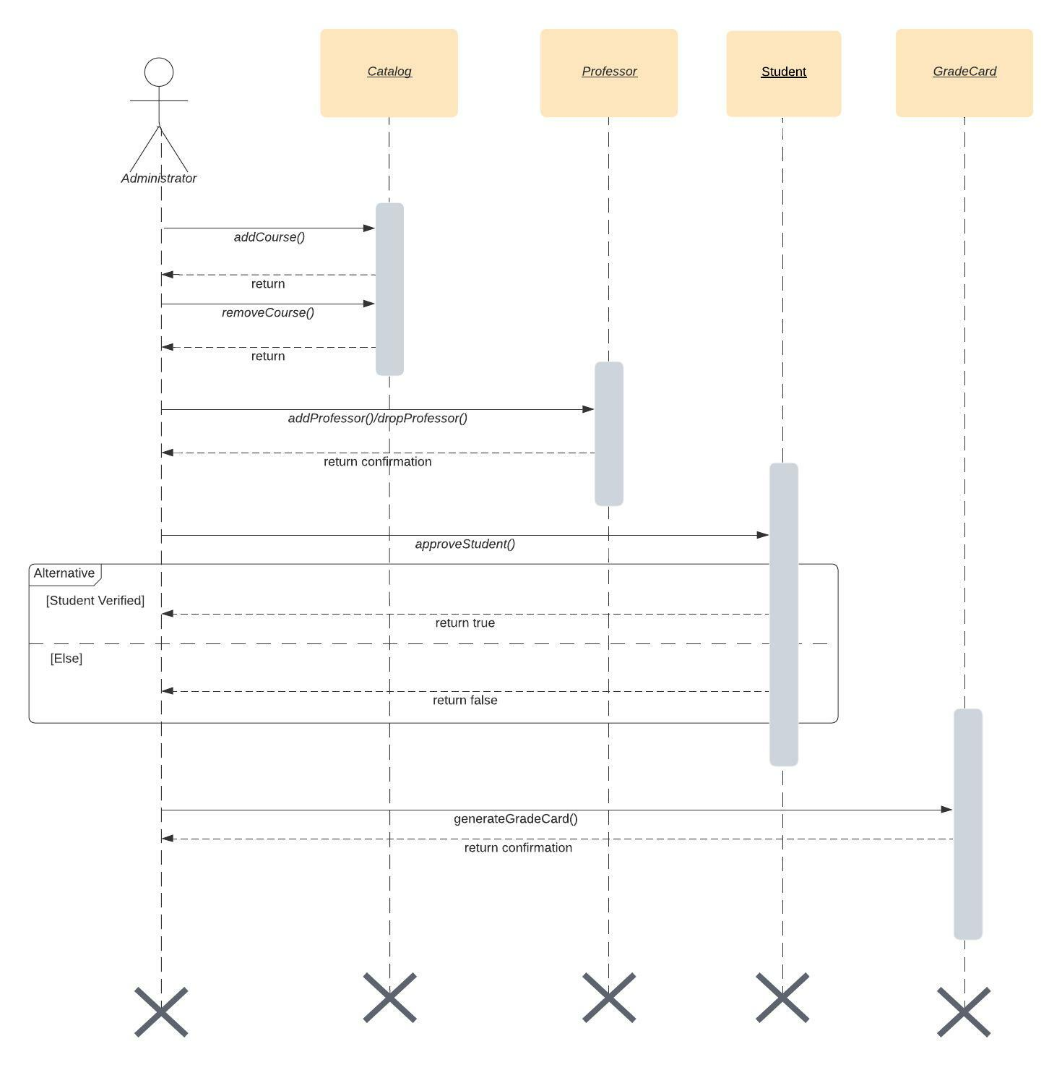
Sequence Diagram - Admin

Slide 29
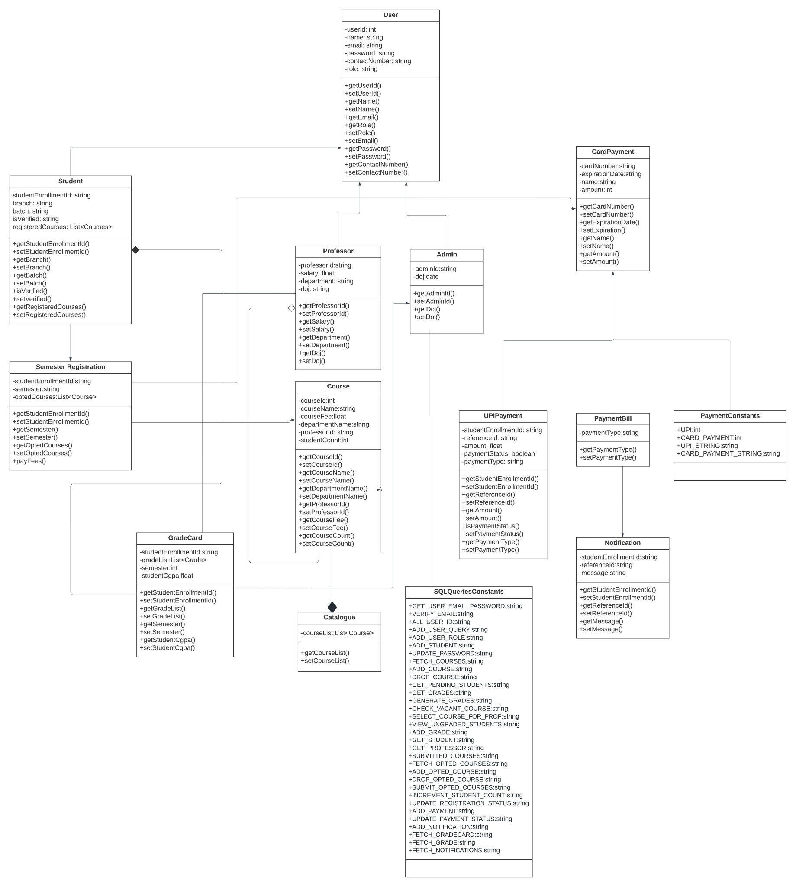
Class Diagram

Slide 30
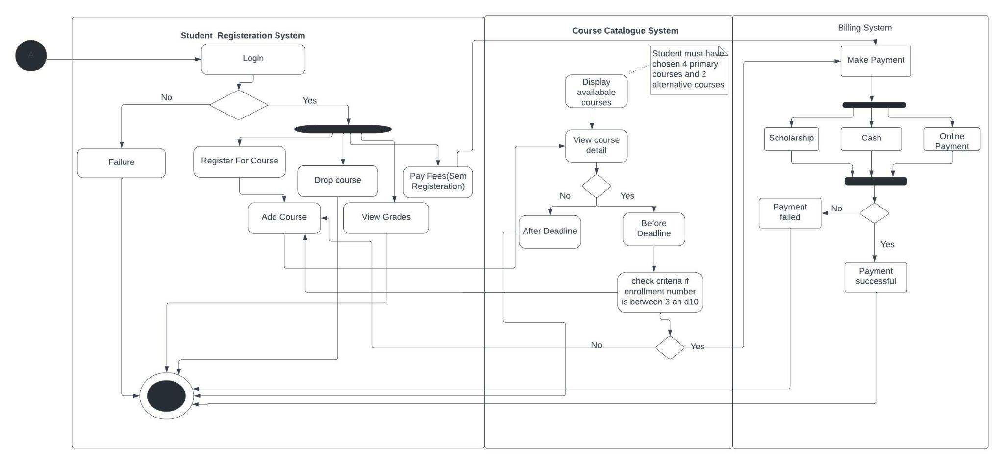
Activity Diagram - Student

Slide 31
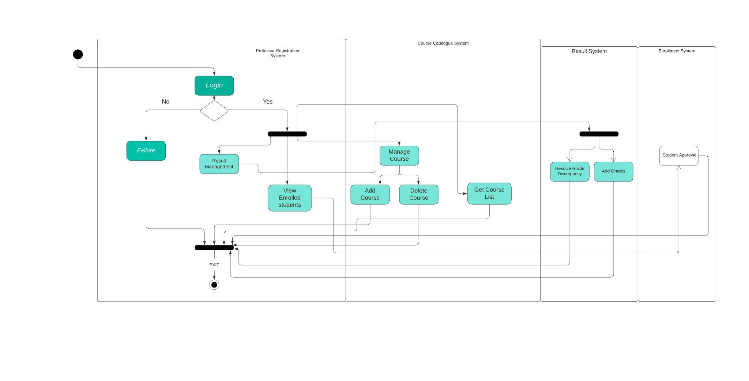
Activity Diagram - Professor

Slide 32
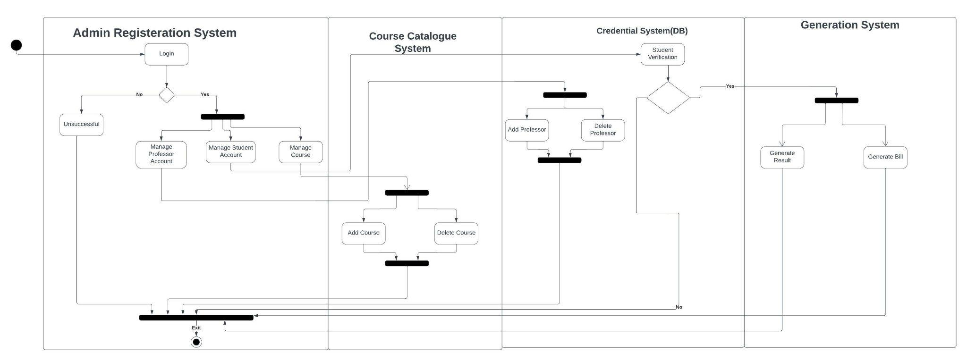
Activity Diagram - Admin

Slide 33

Challenges & Learnings
Notes:
Time – 2 mins

Slide 34
LEARNING
Learning can happen virtually too.
Crystal clear thought process in designing UML diagrams.
Setting up the environment.
Better at writing clean and readable codes
Learn to use production technologies
CHALLENGES
Virtual Learning Experience
Setting the environment.
Initially had trouble in designing UML diagrams

Slide 35

Demo

Slide 36

Questions
Notes:
Time - ?

Slide 37
Thank you
Notes:
Time – After this show the testimonial video. 1 min

